Slide 1
Module 2
Arithmetic and logic Instructions in ARM

Slide 2
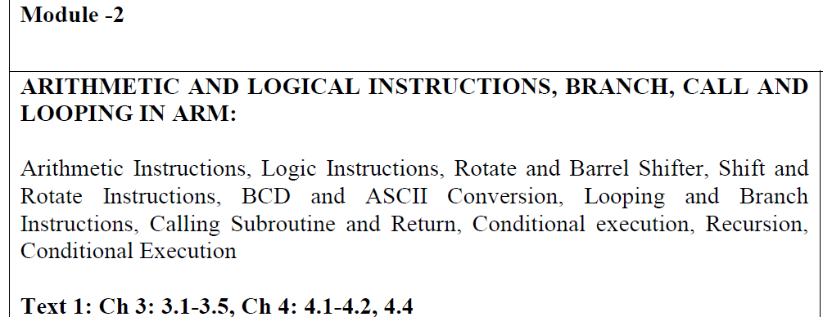

Slide 3
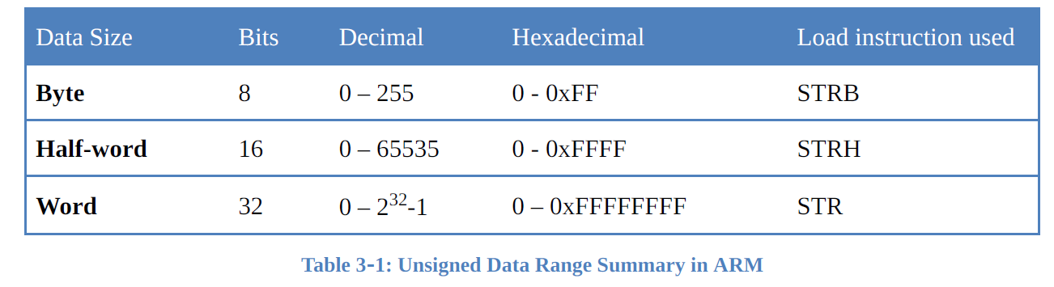
Arithmetic Instruction
Unsigned Numbers – data in which all the bits are used to represent data and no bits are set aside for positive or negative sign.

Slide 4
Affecting Flag in ARM Instruction
A unique feature of the execution of ARM arithmetic instructions is that it does not affect (updates) the flags unless we specify it.
x86 and 8051 the arithmetic instructions automatically change the Z and C flags
ARM instruction is not to affect these flags after the execution of arithmetic instructions such as ADD and SUB.
The ARM assembler gives - option of telling the CPU to update the flag bits in the CSPR register to reflect the result.
We override the default by having letter S in the instruction.
For example, we must use SUBS instead of SUB since the SUB instruction will not update the flags.
The SUBS means subtract and set the flags, while the SUB simply subtracts without having any effect on the flags.

Slide 5
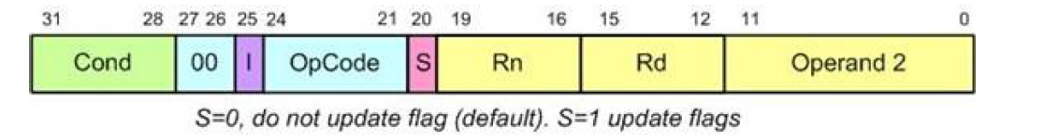
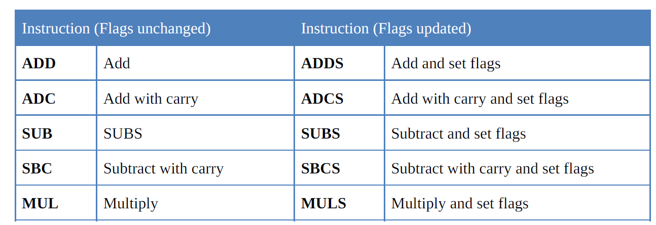

Slide 6
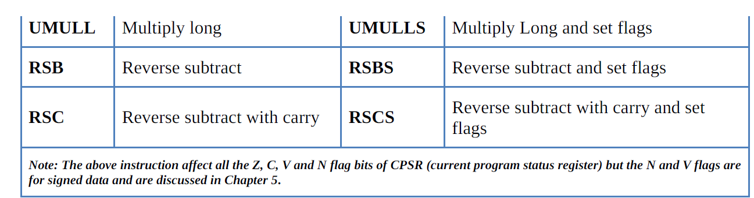

Slide 7
Addition of unsigned numbers
The instructions ADD and ADC are used to add two operands.
The destination operand must be a register. The Op2 operand can be a register or immediate.
Remember that memory-to-register or memory-to-memory arithmetic and logic operations are never allowed in ARM Assembly language since it is a RISC processor.
The instruction could change any of the Z, C, N, or V bits of the status flag register, as long as we use the ADDS instead of ADD.

Slide 8
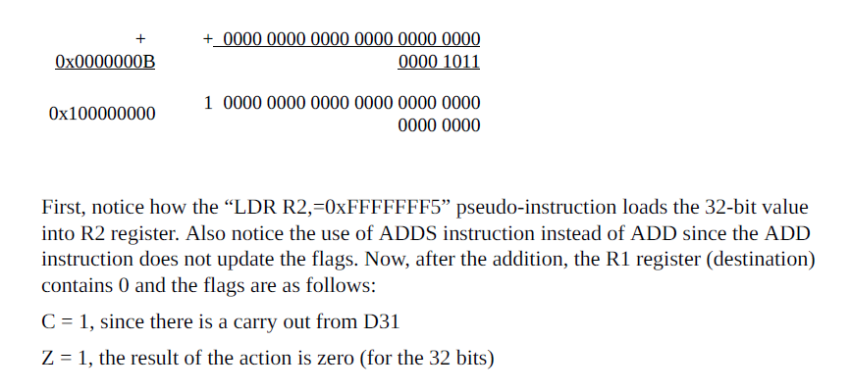

Slide 9
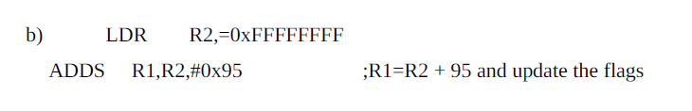
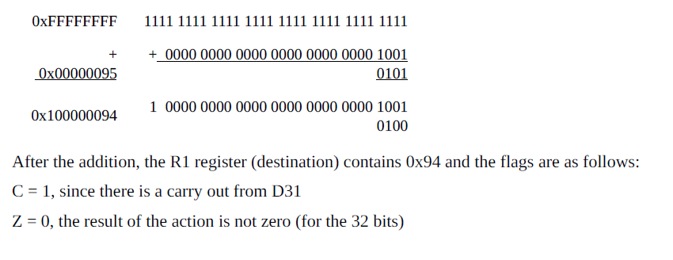

Slide 10
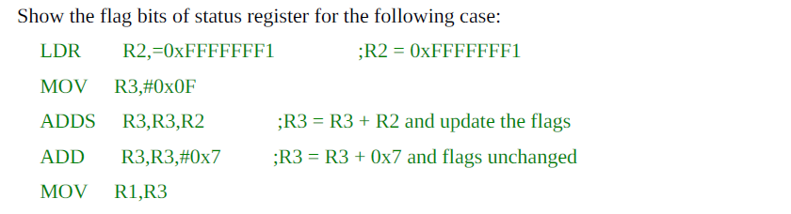
Assignment

Slide 11
No increment instruction in ARM
ADD to perform this action.
The instruction “ADDS R4,R4,#1” will increment the R4 and places the result in R4 register.
ADC (add with carry)
This instruction is used for multiword (data larger than 32-bit) numbers.
The form of the ADC instruction is
ADC Rd,Rn,Op2 ;Rd = Rn + Op2 + C
In addition the following two cases will be examined:
1. Addition of individual word data
2. Addition of multiword data
Notes:
The RISC processors eliminate the unnecessary instructions and use an existing instruction to perform the operation.

Slide 12
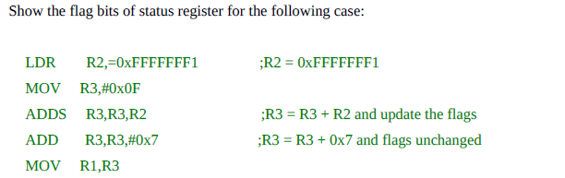
CASE 1: Addition of individual word data
Notes:
In real world to calculate the total sum of any number of operands, the carry flag should be checked
after the addition of each operand to see if the total sum is greater than 0xFFFFFFFF.

Slide 13
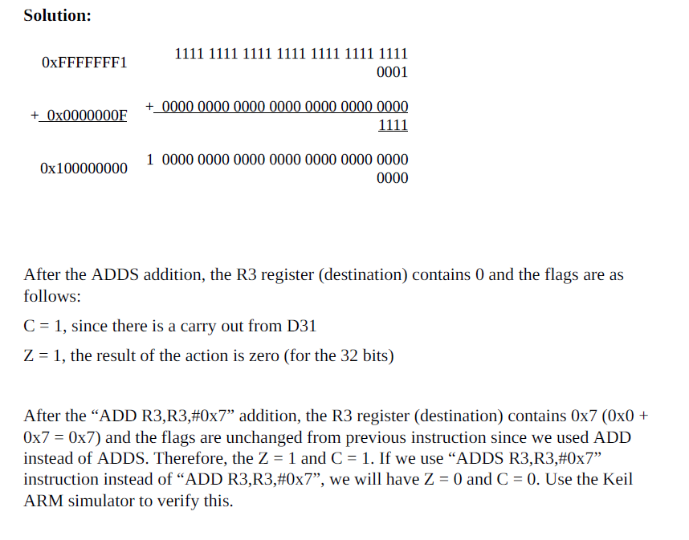

Slide 14
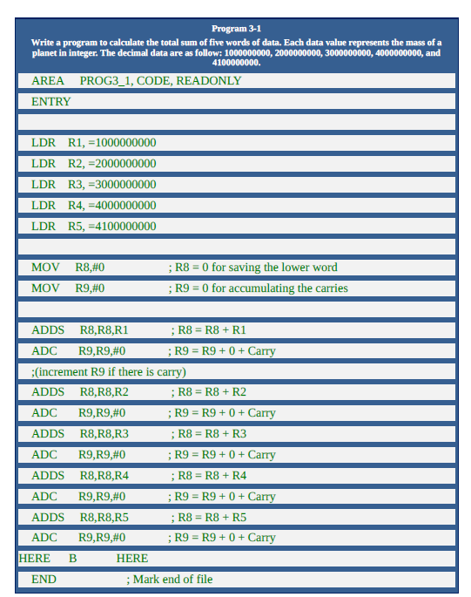

Slide 15
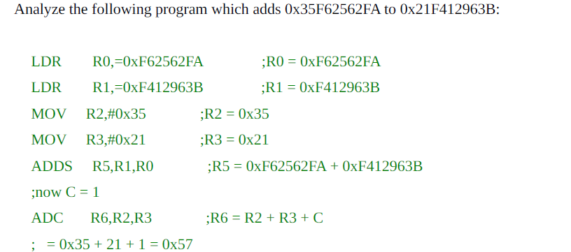
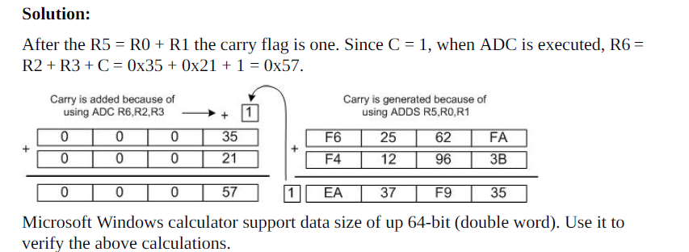
CASE 2: Addition of multiword numbers
Notes:
Assume a program is needed that will add the total U.S. budget for the last 100 years or the mass of all the planets in the solar system. In cases like this, the numbers being added could be up to 8 bytes wide or more. Since ARM registers are only 32 bits wide (4 bytes), it is the job of the programmer to write the code to break down these large numbers into smaller chunks to be processed by the CPU. If a 32-bit register is used and the operand is 8 bytes wide, that would take a total of two iterations.
See Example 3-4. However, if a 16-bit register is used, the same operands would require four iterations. This obviously takes more time for the CPU. This is one reason to have wide registers in the design of the CPU.

Slide 16
Subtraction of unsigned numbers
In subtraction, the ARM microprocessors (indeed, almost all modern CPUs) use the 2’s complement method.
Although every CPU contains adder circuitry, it would be too cumbersome (and take too many logic gates) to design separate subtractor circuitry.
The ARM uses internal adder circuitry to perform the subtraction operation.
Assuming that the ARM is executing simple subtract instructions, one can summarize the steps of the hardware of the CPU in executing the SUB instruction for unsigned numbers as follows:
Take the 2’s complement of the subtrahend (Op2 operand).
Add it to the minuend (Rn operand).
Place the result in destination Rd.
Set the carry flag if there is a carry.
These four steps are performed for every SUBS instruction by the internal hardware of the ARM CPU.
It is after these four steps that the result is obtained and the flags are set.

Slide 17
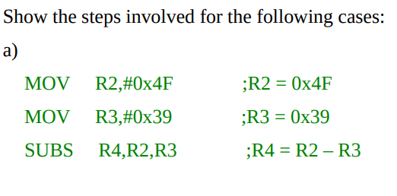
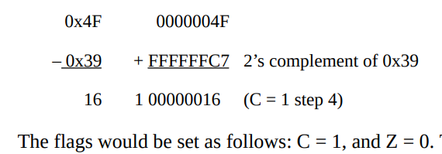
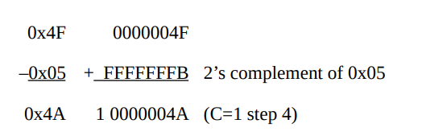
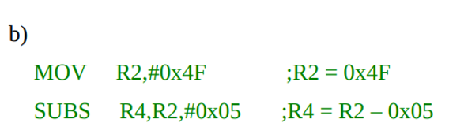
Binary Conversion of 0x39 0000 0000 0000 0000 0000 0000 0011 1001
1’s Complement is 1111 1111 1111 1111 1111 1111 1100 0110
2’s Complement is + 1
1111 1111 1111 1111 1111 1111 1100 0111 = (FFFFFFC7)

Slide 18
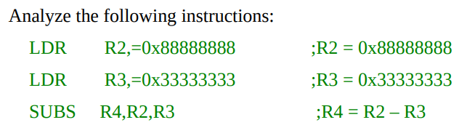
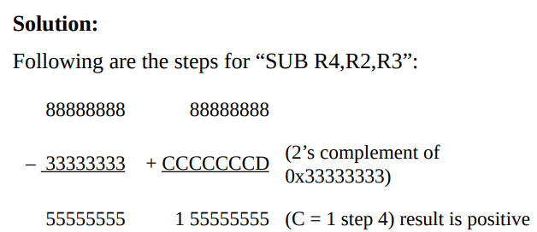
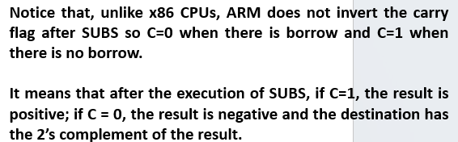

Slide 19
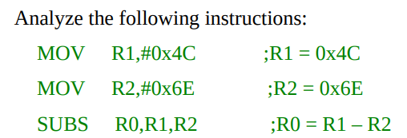
Assignment

Slide 20
SBC (subtract with borrow)
Instruction is used for subtraction of multiword (data larger than 32-bit) numbers.
In some architectures, the CPU inverts the C flag after subtraction so the content of carry flag is the borrow bit of subtract operation.
In ARM the carry flag is not inverted after subtraction and carry flag is invert of borrow.
“Rd = Rn – Op2 – C”
“Rd = Rn – Op2 – 1 + C”
Notes:
In those architectures the subtract with borrow is implemented as “Rd = Rn – Op2 – C”.

Slide 21
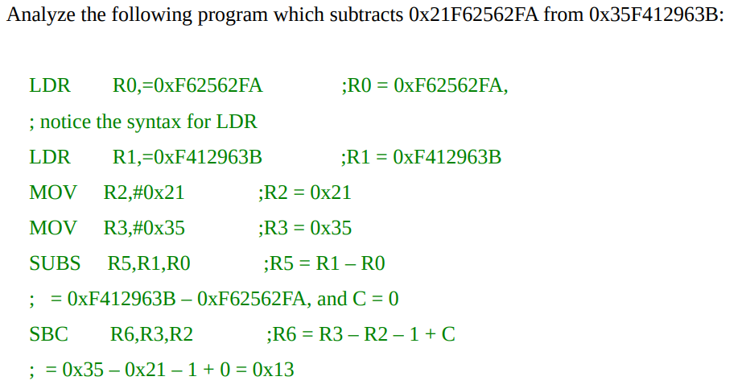
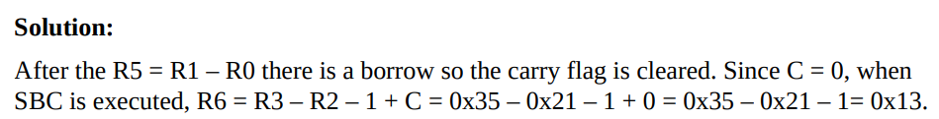
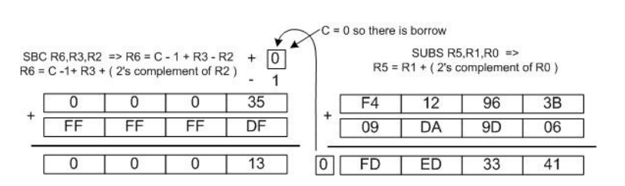

Slide 22
No decrement instruction in ARM
There is no decrement instruction in the ARM processor.
Instead we use SUB to perform the action.
The instruction “SUB R4,R4,#1” will decrement one from R4 and places the result in R4 register.
The RISC processors eliminate the unnecessary instructions and use an existing instruction to perform the desired operation.

Slide 23
RSB (reverse subtract)
The format for the RSB instruction is
Understand the difference between the RSB and SUB instruction.
They are essentially the same except the way the source operands are subtracted is reversed.
This instruction can be used to get 2’s complement of a 32-bit operand.

Slide 24
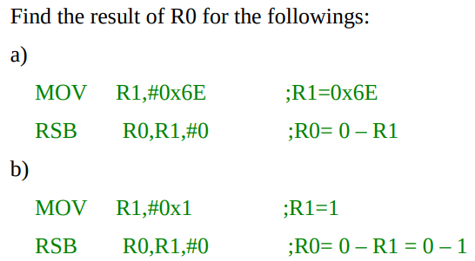
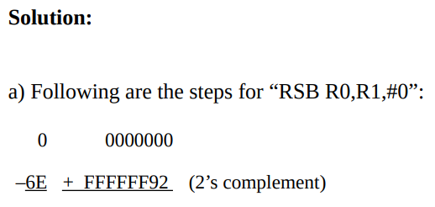
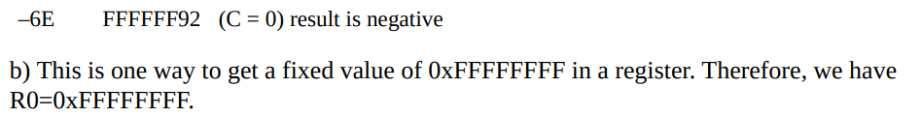

Slide 25
RSC (reverse subtract with carry)
The form of the RSC instruction is
The difference between the RSB and RSC instructions.
They are essentially the same except the way the source operands are subtracted is reversed.
This instruction can be used to get the 2’s complement of the 64-bit operand.

Slide 26
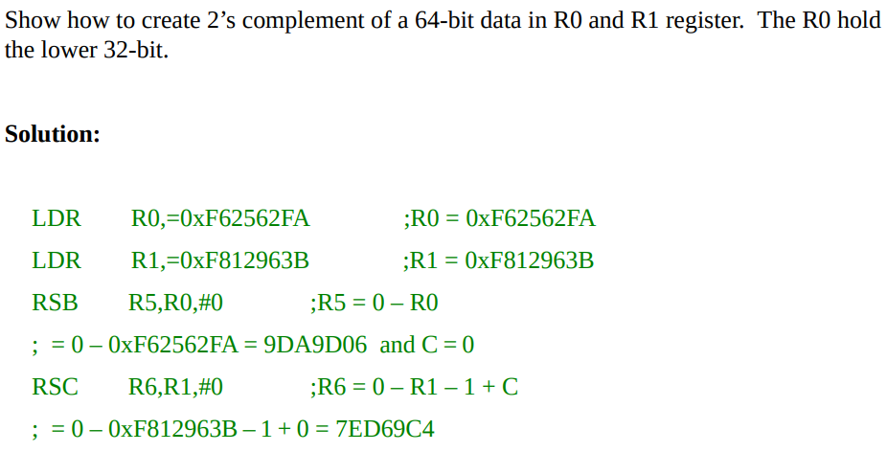

Slide 27
Multiplication and division of unsigned numbers
Not all CPUs have instructions for multiplication and division.
All the ARM processors have a multiplication instruction but not the division.
Some family members such as ARM Cortex have both the division and multiplication instructions.

Slide 28
Multiplication of unsigned numbers in ARM
The ARM gives you two choices of unsigned multiplication:
Normal multiply and
Long multiply.
The normal multiply instruction (MUL) is used when the result is less than 32-bit, while the long multiply (MULL) must be used when the result is greater than 32- bit.

Slide 29
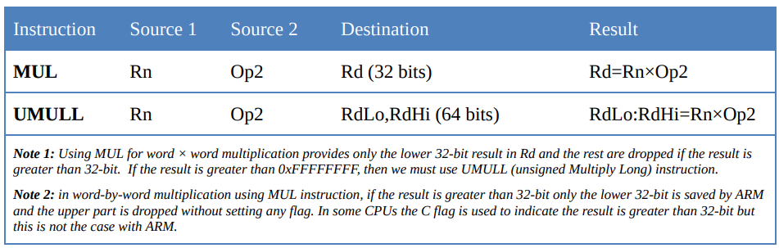

Slide 30

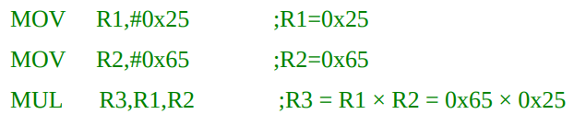
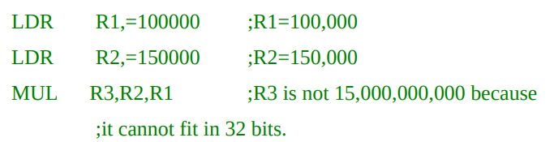
MUL (multiply)
In normal multiplication, the operands must be in registers.
After the multiplication, the destination registers will contain the result.
For this reason we must use UMULL (unsigned multiply long) instruction if the result is going to be greater than 0xFFFFFFFF.
Notes:
Note that in the case of half-word times half-word or smaller sources since the destination register is 32-bit there is no problem in keeping the result of 65,535 × 65,535, the highest possible unsigned 16-bit data.
That is not the case in word times word multiplication because 32-bit × 32-bit can produce a result greater than 32-bit.
If the MUL instruction is used, the destination register will hold the lower word (32-bit) and the portion beyond 32-bit is dropped.
So it is not safe to use MUL for multiplication of numbers greater than 65,536.
In many microprocessors when the result goes beyond the destination register size, the C flag is raised to indicate that.

Slide 31
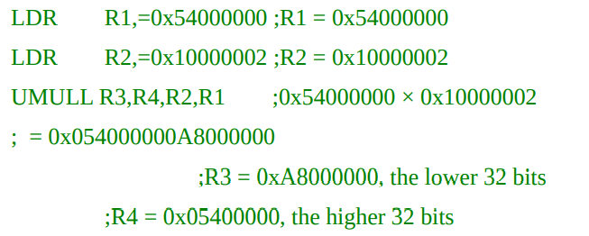
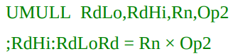
UMULL (unsigned multiply long)
In unsigned long multiplication, the operands must be in registers.
After the multiplication, the destination registers will contain the result.
In example, The left most register, RdLo will hold the lower word and the higher portion beyond 32-bit is saved in the second register, RdHi.

Slide 32
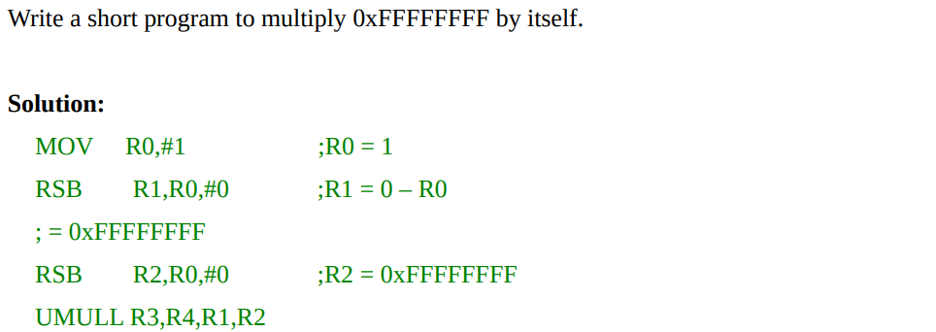
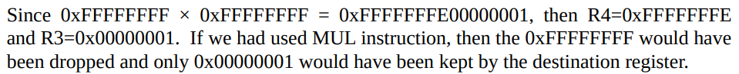

Slide 33
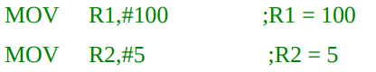
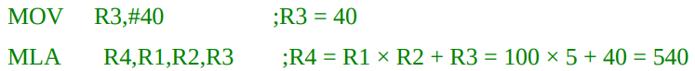
Multiply and Accumulate Instructions in ARM
The format of MLA (multiply and add) instruction is as follows:
Notice that multiply and add can produce a result greater than 32-bit, if the MLA instruction is used, the destination register will hold the lower word (32-bit) and the portion beyond 32-bit is dropped.
For this reason we must use UMLAL (unsigned multiply and add long) instruction if the result is going to be greater than 0xFFFFFFFF.
Notes:
In some application such as digital signal processing (DSP) we need to multiply two registers and add the result with another register. The ARM has an instruction to do both jobs in a single instruction. The format of MLA (multiply and add) instruction is as follows:

Slide 34
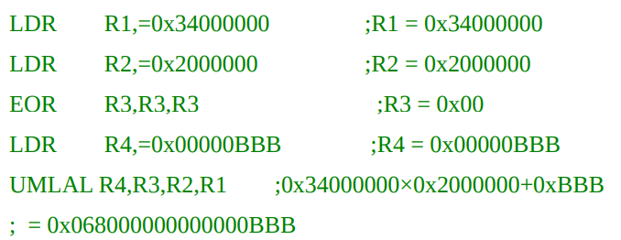
Notes:
In multiplication and add, the operands must be in registers. Notice that the addend and the high word of the destination use the same registers, the two left most registers in the instruction. It means that the contents of the registers which have the addend will be changed after execution of UMLAL instruction. See the following example:

Slide 35
Division of unsigned numbers in ARM
Some ARM families do not have an instruction for division of unsigned numbers since it takes too many gates to implement it.
We can use SUB instruction to perform the division.

Slide 36
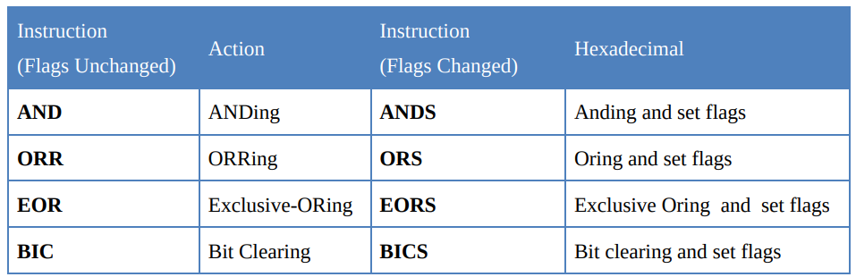
Logic Instructions
Notes:
Just like arithmetic instruction, we must use the S in the instruction syntax if we want to update the flags. If the S syntax is used the Z flag will be set if and only if the result is all zeros, and the N flag will be set to the logical value of bit 31 of the result. The V flag in the CPSR will be unaffected, and the C flag will be set to the carry out from the barrel shifter which is discussed in the next section.

Slide 37
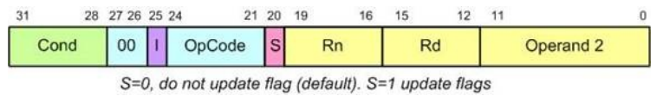
General Formation of Data Processing Instruction

Slide 38
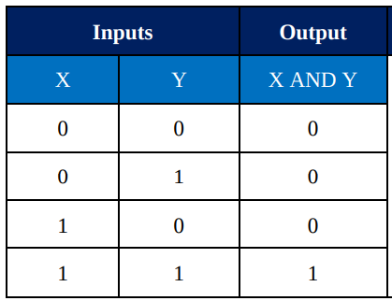
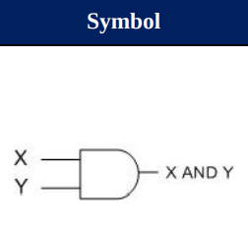
AND
If we use ANDS instead of AND it will change the C and Z flags according to the result.

Slide 39
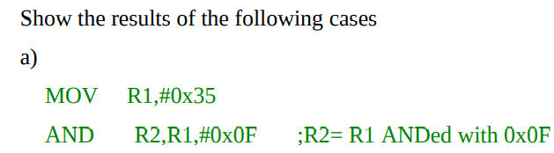
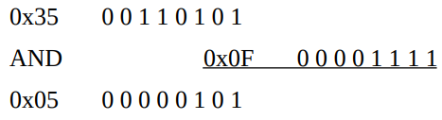
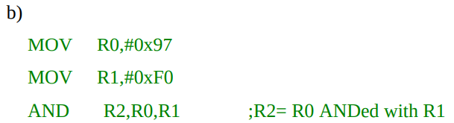
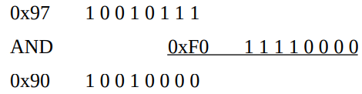

Slide 40
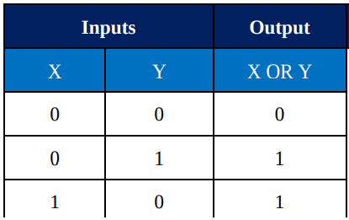
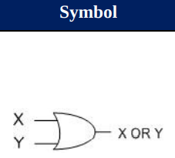
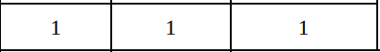
ORR
If we use ORRS instead of ORR, the flags will be updated, just the same as for the ANDS instruction.

Slide 41




The ORR instruction can also be used to test for a zero operand. For example, “ORRS R2,R2,#0” will OR the register R2 with zero and make Z = 1 if R2 is zero.

Slide 42


EOR
The flags are updated if we use EORS instead of EOR.

Slide 43





Slide 44

Solution:
EOR can also be used to see if two registers have the same value.
Another widely used application of EOR is to toggle bits of an operand.
0x45 0 1 0 0 0 1 0 1
XOR 0x45 0 1 0 0 0 1 0 1
0x00 0 0 0 0 0 0 0 0

Slide 45



BIC (bit clear)
If we want the flags to be updated, then we must use BICS instead of BIC.

Slide 46

MVN (move negative)
MVN (move negative) instruction is used to generate one’s complement of an operand.
1010
0xA 1010 1010 1010 1010 1010 1010 1010

Slide 47
Shift and Rotate Instructions in ARM Cortex
Rotate and Barrel Shifter
The process instructions can be used in one of the following forms:
opcode Rd, Rn, Rs
(e.g. ADD R1,R2,R3)
opcode Rd, Rn, immediate Value
(e.g. ADD R2,R3,#5)

Slide 48


Barrel Shifter
They are used for move, arithmetic, logical, comparison and multiply instructions.
Most data processing instructions can process one of their operands using the barrel shifter.
There are two kinds of shifts:
Logical and
Arithmetic.

Slide 49



Slide 50





Logical Shift Right (LSR)
The operand is shifted right bit by bit, and for every shift the
LSB (least significant bit) will go to the carry flag (C) and
MSB (most significant bit) is filled with 0.
Use an immediate operand or a
register to hold the number of times it is to be shifted.
LSR does affect the S and Z flags.
If you want the flags to be set, use the MOVS instruction instead of MOV.

Slide 51


Assignment
After four shifts, the R3 will contain 0x77.
After the three shifts, the R1 will contain 0x11.

Slide 52





Logical Shift Left (LSL)
Use an immediate operand or a
register to hold the number of times it is to be shifted left.
After every shift, the LSB is filled with 0 and the MSB goes to C.
The eight MSBs are lost through the carry, one by one, and 0s fill the eight LSBs.
After eight shifts left, the R2 register has 0x00000600 and C = 1

Slide 53

Assignment
After the five shifts, the R1 will contain 0x000000E0. 0xE0 is 224 in decimal.

Slide 54


Slide 55



Arithmetic shift - ASR (arithmetic shift right)

Slide 56





Rotating the bits of an operand right and left
There are two types of rotations.
Simple rotation of the bits of the operand
Rotation through the carry
ROR (rotate right)

Slide 57


Rotate left
To do rotate left we must use 32-n for the number of rotation right.
Therefore, “MOV R0,#0xFF,#30” is the same as rotating left 2 times
and
“MOV R0,#0xFF,#28” is the same as rotating left 4 times. See Examples 3-21 through 3-23.
There is no rotate left option in ARM7 we can use the rotate right (ROR) to do the job.
Instead of rotating left n bits we can use rotate right 32–n bits to do the job of rotate left.

Slide 58


Slide 59

RRX rotate right through carry
In RRX, as bits are shifted from left to right, they exit from the right end (LSB) to the carry flag, and the carry flag enters the left end (MSB).
In RRX the LSB is moved to C and C is moved to the MSB.
In reality, C flag acts as if it is part of the operand.
The RRX is like 33-bit register since the C flag is 33th bit.
The RRX takes no arguments and the number of times an operand to be rotated is fixed at one.

Slide 60


Slide 61




Slide 62

Shifting Immediate Arguments

Slide 63


General Formation of Process instruction

Slide 64


Slide 65


Slide 66


Slide 67









Slide 68

BCD and ASCII Conversion
BCD number system
Binary coded decimal
BCD is needed because we use the digits 0 to 9 for numbers.
BCD system is widely used in real-time clock (RTC) of the embedded systems.
Binary representation of 0 to 9 is called BCD.

Slide 69
BCD Numbers
Unpacked BCD
Packed BCD
In unpacked BCD, the lower 4 bits of the number represent the BCD number and the rest of the bits are 0.
For example, “0000 1001” and “0000 0101” are unpacked BCD for 9 and 5, respectively.
In the case of unpacked BCD it takes 1 byte of memory location or a register of 8 bits to hold the number.
In the case of packed BCD, a single byte has two BCD numbers in it, one in the lower 4 bits and one in the upper 4 bits.
For example, “0101 1001” is packed BCD for 59. It takes only 1 byte of memory to store the packed BCD operands.
This is one reason to use packed BCD since it is twice as efficient in storing data.

Slide 70

ASCII numbers

Slide 71


ASCII to unpacked BCD conversion
ASCII to unpacked BCD conversion
To convert ASCII data to unpacked BCD, the programmer must get rid of the tagged “011” in the upper 4 bits of the ASCII.
To do that, each ASCII number is ANDed with “0000 1111” (0x0F).
ASCII to packed BCD conversion
To convert ASCII to packed BCD, it is first converted to unpacked BCD (to get rid of the 3) and then combined to make packed BCD.
Packed BCD to ASCII conversion
To convert packed BCD to ASCII, it must first be converted to unpacked and then the unpacked BCD is tagged with 011 0000 (0x30).
Notes:
For data to be displayed on the monitor or be printed by the printer, it must be in ASCII format. Conversion from packed BCD to ASCII is discussed next. To convert packed BCD to ASCII, it must first be converted to unpacked and then the unpacked BCD is tagged with 011 0000 (0x30).

Slide 72


ASCII to packed BCD conversion
Packed BCD to ASCII conversion

Slide 73


Branch, Call, and Looping in ARM
Looping in ARM
Repeating a sequence of instructions or an operation a certain number of times is called a loop.
Notes:
In the above program, we add 0x9 to R0 six times. That makes 6 × 9 = 54 = 0x36. One problem with the above program is that too much code space would be needed to increase the number of repetitions to 50 or 1000. A much better way is to use a loop. Next, we describe the method to do a loop in ARM.

Slide 74


Using instruction BNE for looping
Uses the zero flag in the status register.
BNE (branch if not equal)

Slide 75




Notes:
In the last two instructions, the Rn (e.g. R2 or R3) is decremented; if it is not zero, it branches (jumps) back to the target address referred to by the label. Prior to the start of the loop, the Rn is loaded with the counter value for the number of repetitions. Notice that the BNE instruction refers to the Z flag of the status register affected by the previous instruction, SUBS.
In the program in Example 4-1, register R2 is used as a counter. The counter is first set to 1000. In each iteration, the SUBS instruction decrements the R2 and sets the flag bits accordingly. If R2 is not zero (Z = 0), it jumps to the target address associated with the label “AGAIN”. This looping action continues until R2 becomes zero. After R2 becomes zero (Z = 1), it falls through the loop and executes the instruction immediately below it, in this case “MOV R4,R0”. It must be emphasized again that we must use SUBS instead of SUB since the SUB instruction will not change (update) the flags. Since we are monitoring the Z flag for the loop counter we must use SUBS instruction for the decrementing the counter. As we mentioned in Chapter 3, many of the ARM instructions have the option of affecting the flags. In these instructions the default is not to affect the flags. Therefore to make them to effect the flag we must add letter S to the instruction. That means SUBS and ADDS instructions are different from SUB and ADD, as far as the flags are concerned.

Slide 76


Looping a trillion times with loop inside a loop
Write a program to
load the R0 register with the value 0x55, and
complement it 16,000,000,000 (16 billion) times.
In a nested loop, we use two registers to hold the count.
Notes:
n this program, R1 is used to keep the inner loop count. In the instruction “BNE L2”, whenever R1 becomes 0 it falls through and “SUBS R2,R2,#1” is executed. The next instructions force the CPU to load the inner count with 1,000,000,000 if R2 is not zero, and the inner loop starts again. This process will continue until R2 becomes zero and the outer loop is finished. If you use the Keil IDE to verify the operation of the above program use smaller values for counter to go through the iterations.

Slide 77


Slide 78


Slide 79


Slide 80


Slide 81


Slide 82


Slide 83



Slide 84


Slide 85


Slide 86


Slide 87


Slide 88


Slide 89





BCC (branch if carry clear, branch if C = 0

Slide 90




Comparison of unsigned number

Slide 91


Slide 92


Slide 93


Slide 94



Division of unsigned numbers in ARM

Slide 95


TST (Test)

Slide 96


Slide 97


Unconditional branch (jump) instruction
The unconditional branch is a jump in which control is transferred unconditionally to the target location.
In the ARM there are two unconditional branches: B (branch) and BX (branch and exchange).
B (Branch)
B (branch) is an unconditional jump that can go to any memory location in the 32M byte address space of the ARM.
Another syntax for B instruction is BAL (branch always).
B has different usages like implementing if/else, while, and for instructions.

Slide 98
All branches are short branches (jumps)
It must be noted that all branch instructions (conditional and unconditional) are short jumps
Meaning the address of the target must be within 32M bytes of the program counter(PC).
That means the short jumps cannot cover the entire address space of 4G bytes (0x00000000 to 0xFFFFFFFF).

Slide 99
Calculating the short branch address
All conditional branches such as BCC, BEQ, and BNE are short branches.
This is due to the fact that the ARM instructions are 32-bit and some of the 32-bit must be used for opcode
Therefore it cannot cover the entire 4G bytes address space of ARM.
In the branch instruction the opcode is 8 bits and the relative address is 24 bits.

Slide 100


Slide 101
Calculating the short branch address
The target address is relative to the value of the program counter.
If the relative address is positive, the jump is forward.
If the relative address is negative, then the jump is backwards.
The relative address can cover memory space of –32Mbytes to +32Mbytes from current location of program counter.

Slide 102
Calculating the short branch address
The reason for 32MB is the fact that 24 bits are shifted left twice (multiplied by 4) by the ARM CPU automatically.
That gives us 26 bits.
Now, since one bit is used for positive or negative sign, we have only 25 bits for magnitude.
The 25 bits magnitude gives us 32M bytes (2^25 = 32M) in each direction.
That is –32Mbytes if it is backward and +32MB if it is forward jump.

Slide 103
Calculating the short branch address
Therefore, to calculate the target address, the relative address is shifted left twice and added to the address of the next instruction to be fetched
[target address = relative address shifted left twice + address of the next instruction to be fetched].
The next instruction to be fetched is two instructions below the current branch instruction.
The reason is the instruction right below the branch is already in the pipeline. See Figure 4-5.

Slide 104
You might ask why we add the relative address to the address of two instructions below the current instruction.
(why don’t we add the relative address to the address of the instruction right below the current instruction as it is in other CPUs). This is due to the pipeline issues as we will see in next section and Chapter 7.

Slide 105
Branching beyond 32M byte limit
To branch beyond the address space of 32M bytes, we use BX (branch and exchange) instruction.
The “BX Rn” instruction uses register Rn to hold target address.
Since Rn can be any of the R0–R14 registers and they are 32-bit registers, the “BX Rn” instruction can land anywhere in the 4G bytes address space of the ARM.

Slide 106
Branching beyond 32M byte limit
In the instruction “BX R2” the R2 is loaded into the program counter (R15) and CPU starts to fetch instructions from the target address pointed to by R15, the program counter.
See Figure 4-6.
Since the instructions are word aligned, we must make sure that the lower two bits of the Rn are 0s.

Slide 107


Slide 108
Calling Subroutine with BL
Another control transfer instruction is the BL (branch and link) instruction, which is used to call a subroutine.
Subroutines are often used to perform tasks that need to be performed frequently.
This makes a program more structured in addition to saving memory space.
In the ARM there is only one instruction for call and that is BL (branch and link).
To use BL instruction for call, we must leave the R14 register unused since that is where the ARM CPU stores the address of the next instruction where it returns to resume executing the program.

Slide 109
BL (Branch and Link) instruction and calling subroutine
In the 32-bit instruction BL, 8 bits are used for the opcode and the other 24 bits, k23–k0, are used for the address of the target subroutine, just like in the Branch instruction.
Therefore, BL can be used to call subroutines located anywhere within the 32M address space of the ARM, as shown in Figure 4-7.

Slide 110


Slide 111
BL (Branch and Link) instruction and calling subroutine
To make sure that the ARM knows where to come back to after execution of the called subroutine, the ARM automatically saves in the link register (LR), the R14, the address of the instruction immediately below the BL.
When a subroutine is called by the BL instruction, control is transferred to that subroutine, and the processor saves the PC (program counter) in the R14 register and begins to fetch instructions from the new location.
After finishing execution of the subroutine, we must use “BX LR“ instruction to transfer control back to the caller.
Every subroutine needs “BX LR” as the last instruction for return address.

Slide 112
BL instruction and the role of linker register
When a subroutine is called using BL instruction, first the processor saves the address of the instruction just below the BL instruction on the R14 register (LR, linker register), and then control is transferred to that subroutine.
This is how the CPU knows where to resume when it returns from the called subroutine.

Slide 113
The linker register and returning from subroutine
There is no RETurn instruction in ARM7.
Therefore at the end of the subroutine we must copy the linker register, R14, to the program counter (R15).
When the BL instruction is executed the address of the instruction below the BL instruction is placed into R14 register, so, when the execution of the function finishes, the address of the instruction below the BL must be reloaded back into the PC, and so the CPU can resume the execution of instructions below the BL instruction.

Slide 114


Slide 115


Slide 116


Slide 117


Slide 118


Slide 119


Slide 120


Slide 121



Slide 122


Notes:
First notice that the B instruction in line 4 jumps forward. To calculate the target address, the relative address (offset) is shifted left twice and added to the PC of the next instruction to be fetched. The position of the next instruction to be fetched is 2 instructions below the current instruction. Recall that each instruction of ARM takes 4 bytes. So the next instruction to be fetched is 2 × 4 bytes = 8 bytes below the current instruction address (00000004). So the address of the next instruction to be fetched is 0000004 + 8 = 000000C (the position of MOV instruction in line 6). In line 4 the instruction “B THERE” has the machine code of EA000002. To distinguish the operand and opcode parts, we should compare the machine code with the B instruction format. In the following, you see the format of the B instruction. In this example the machine code is EA000002. If we compare it with the B format, we see that, the operand is 000002 and the opcode is EA. The 000002 is the offset, relative to the address of the next instruction. Recall that to calculate the target address, the relative address (offset) is shifted left twice and added to the current value of the PC (Program Counter). Shifting the offset (000002) left twice results in 000008 and then adding it to the address of the next instruction to be fetched (0000000C) we have 000008 + 0000000C = 00000014 which is exactly the address of THERE label. All the jump instructions, whose mnemonics begin with B, have the same instruction format, and the opcode changes from instruction to instruction. So, we can calculate the short branch address for any of them, as we just did in this example.

Slide 123


Slide 124


Slide 125




Slide 126



Slide 127



